Slide 1
Chapter 5 – Model quality
Artificial Intelligence

Slide 2
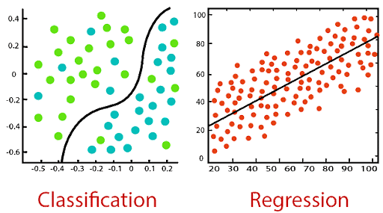
Model types
When doing machine learning, there are two types of model:
Classification
Student will pass/fail (binary)
Weather will be bad/fine/good/very good
Regression
Student will have 72%
Temperature will be 25°

Slide 3
Model quality
You’ve made a model, but now you need to test how good the model is
Before training, hold back some data that the model won’t get to ‘see’
Train, test, validation (see next slide)
Let the model predict this data and compare the results with what you know should be the outcome
Regression:
RMSE
Classification:
Confusion matrix

Slide 4
Train, test, validation
You split your data in three parts. The exact percentages differ, but training is the biggest (70%-80%), and the remainder is divided equally between validation and test.
Data should be divided using the same probability distributions. (Don’t take the top X rows from a sorted dataset.)
Sometimes you only use a training and a test-set:
Train the model and test it once
When you can adjust parameters on the model, you need a validation-set
Train model using param X, validate, set param Y, train again, validate, …
Finally test the final model using the (until then unseen) test-set
Notes:
https://en.wikipedia.org/wiki/Training,_validation,_and_test_data_sets

Slide 5
Regression model quality
When doing regression, assessing model quality is quite easy with the RMSE
It’s a measure for how far the predicted values where from the actual value
Lower is better
RMSE already penalizes large errors and the unit is the same as the actual data
When predicting temperature the unit of the RMSE will also be “degrees”, not “degrees²”
There are alternatives
MAE (Mean Absolute Error) – more robust to outliers
R² (Coefficient of Determination) – measures proportion of variance explained

Slide 6
Classification model: Cat or not cat?
This powerpoint uses the very bad “is it a cat or not a cat”-model
This is a bad model for 2 reasons:
Cat or not cat is a deep learning model, where we are working with machine learning. The results of a machine learning model are the same though, but less graphical (a fraudulent transaction is nowhere near as cute as a cat).
The model is awful. Any script-kiddy copying from youtube can make a better cat-dog model. The reason we work with such a bad model is because that makes it easier to align the results with the model. (0,9987 is less than 0,99978, but it easier to see the difference between 0,18 and 0,64)

Slide 7
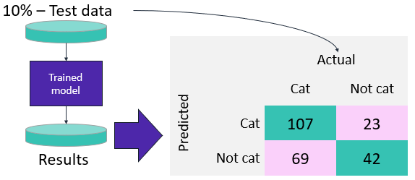
Classification model quality
A confusion matrix shows the number…
Of predicted cats that where cats
Of predicted cats that where not cats
Of predicted not cats that where cats
Of predicted not cats that where not cats
Which gives you a lot of information, but what is better?
A model that predicts to many cats
A model that predicts to many not cats

Slide 8
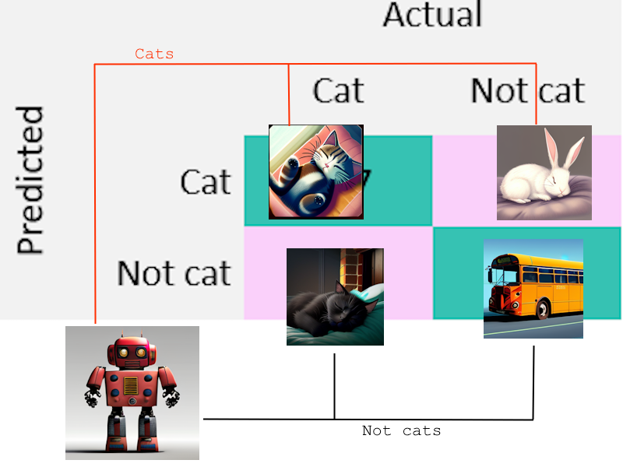
Confusion matrix
A very simple confusion matrix for a binary classifier
With examples:
True positive (TP) Predicted a cat and it was a cat
False positive (FP) Predicted not a cat and it was a cat
False negative (FN) Predicted a cat and it was not a cat
True negative (TN) Predicted not a cat and it was not a cat

Slide 9
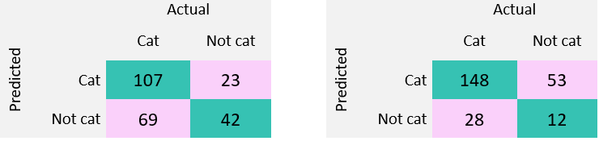
Confusion matrix
A confusion matrix sounds easy, but which of the above is the better model?
Left model got 92 images wrong, the one on the right only 81.
The one on the right also labels a lot of images as cats. Is that a problem?
The solution: you do calculations using TP, TN, FP and FN and compare these numbers

Slide 10
Sensitivity (recall)
Sensitivity measures the proportion of actual positive instances that are correctly identified by the model.
Sensitivity = TP / (TP + FN)
High sensitivity: model is good at identifying positive instances
Example: in a medical setting low FN is important as it’s better to have received treatment for an illness you don’t have that to not have treatment for an illness you do have.

Slide 11
Sensitivity (recall)
Left: 0.608, right: 0.841
Right is higher. It has more correctly identified cats.
Right also called a lot of stuff that wasn’t a cat a cat, but sensitivity doesn’t take that into account.
We prefer a false alarm (FP) over a missed case (FN)

Slide 12
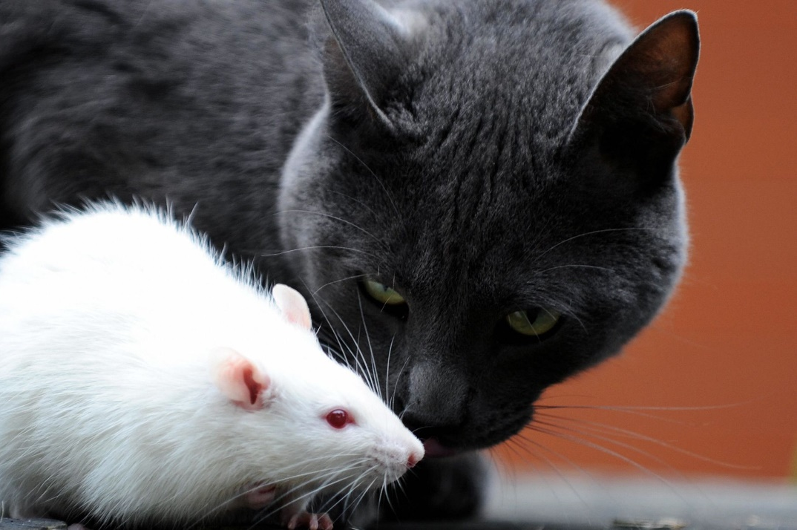
Cat or rat?
You find a lovely animal in an alley, but only want to keep it if it’s a cat (not when it’s a rat)
The good scenarios:
TP: It’s a cat and you keep it
TN: It’s not a cat and it’s exterminated
The bad scenarios:
FP: It’s not a cat and you keep it (can be undone at a later date)
FN: It’s a cat but it’s exterminated
(can’t be undone, should be avoided)

Slide 13
Specificity
True negative rate, the opposite of sensitivity
Specificity = TN / (TN + FP)
High specificity: model is good at finding negative instances
A false positive (saying the patient has cancer when they don’t) could lead to unnecessary treatment, which might be invasive or harmful.
So:
You want to be sure someone truly has the disease before taking drastic action.
It’s better to miss a few real cases than to wrongly treat healthy people.

Slide 14
Specificity
Left: 0.646, right: 0.185
Left is higher. It has less wrongfully identified cats.
Left also missed a lot of actual cats (FN, 69) but was better at finding the actual not cats (42 vs 12 on the right).
We prefer a missed case (FN) over a false alarm (FP)

Slide 15
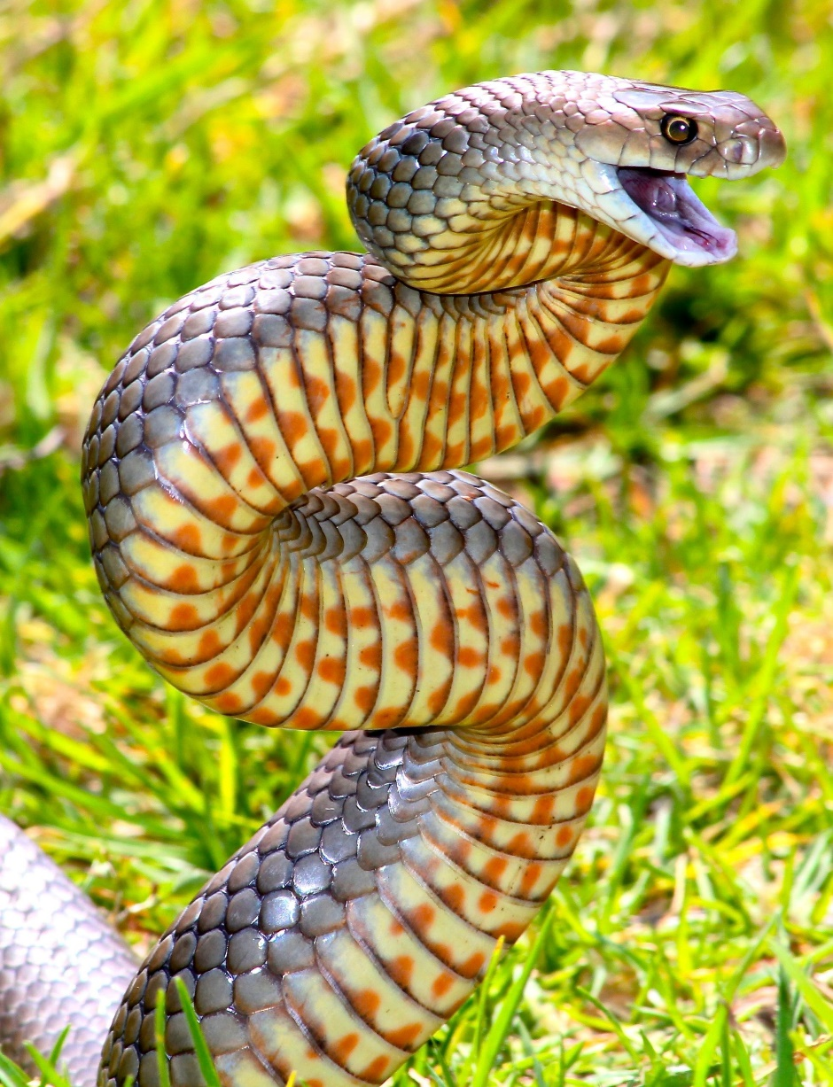
Good or bad snake?
You find a lovely snake in an alley, but only want to keep it if it’s safe (not poisonous)
The good scenarios:
TP: It’s safe and you keep it
TN: It’s poisonous and it’s exterminated
The bad scenarios:
FP: It’s poisonous and you keep it (you die)
FN: It’s safe but it’s exterminated
(a pity, but you live to see another day)

Slide 16
Tot hier

Slide 17
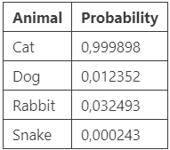
Thresholds
Basic models (decision trees, random forests, …) return a binary classifier. More advanced models (XGBoost, linear learner, …) tend to give a probability
Example:
You may state an animal is a cat if the probability of “cat” is higher than all other animals. But what if we upload a bus “cat” is 0,00021% and “dog” is 0,00018%?
Changing the thresholds is an easy way of changing sensitivity and specificity. Could we make a graph of the different settings to choose the best one?

Slide 18
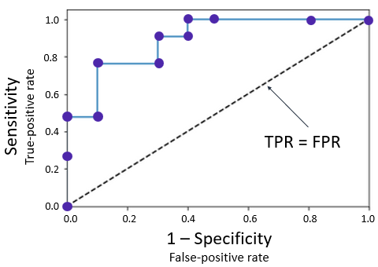
ROC
A receiver operating characteristic (ROC) graph summarizes all the confusion matrices that each threshold produced. To build one, you calculate the sensitivity (or true-positive rate) against the false-positive rate for each threshold value.
(0,0): Everything is a cat
(1,1): Everything is not a cat
(0,1): Best possible model
(1,0): Worst possible model
Line from (0,0) to (1,1): random classifier
Best model, wrong labels!

Slide 19
ROC
The ROC does not help improving the model, it helps tuning the model to the use case
False positives are a major issue?
False negatives are a major issue?
You need a well balanced model?
An ROC does show if a model is better if it’s further away from the diagonal
The diagonal is a random classifier: wrong as much as it is right

Slide 20
AUC-ROC
Suppose you have a new dataset and created some ROC-curves for different models. What easy way is there to see which is the better model?
Measure the area under the curve! Bigger means further from diagonal, means better.
A percentage of 100% would be an ROC-curve that fills the entire surface, a perfect model.
A percentage of 50% would be an ROC-curve that exactly follows the diagonal, which is the worst model possible (a random estimator).
A percentage of 0% would be another perfect model with bad labeling.

Slide 21
Accuracy
Sensitivity and specificity only look at two of the values of the confusion matrix
Accuracy looks at all four
Accuracy = (TP + TN) / (TP + TN + FP + FN)
It’s a good general matrix, but tends to miss low specificity

Slide 22
Precision and F1-score
When false positives are a problem, precision is a good metric
Precision = TP / (TP + FP)
F1-score (or F-measure or balanced F-score) calculates the harmonic mean of precision and sensitivity
Good for both balanced and imbalanced datasets
F1 = (2* precision * sensitivity) / (precision + sensitivity)

Slide 23
Summary
Sensitivity (or recall): find positive instances
Sensitivity = TP / (TP + FN)
Specificity: find negative instances
Specificity = TN / (TN + FP)
ROC: alter thresholds, draw curve
AUC-ROC: Area under said curve (as percentage)
Accuracy: Use all the metrices
Accuracy = TP + TN / (TP + TN + FP + FN)
Precision: use when false positives are a problem
Precision = TP / (TP + FP)
F1-score: use on imbalanced datasets
F1 = (2* precision * sensitivity) / (precision + sensitivity)

Slide 24
Regression
Just to be clear: all these metrics only work when doing classification
“Is it going to be good or bad weather?”
“Can I win the tour de Flanders for amateurs?”
“How many years would it take for this student to graduate?”
When doing regression…
“What will the temperature be?”
“Which position could I get in the the tour de Flanders for amateurs?”
“What are the odds of this student graduating in three years?”
Use RMSE

Slide 25
Back to work!
As said before, this slide is available as a notebook.
After that we’ll use PyCaret
Give it some data
PyCaret creates a bunch of models for us
We check the parameters and decide which we want to use
But first we need to install PyCaret, which is tricky

